Slide 1

CSE567:CLOUD COMPUTING PARADIGMS
L T P : 3 0 0
www.lpu.in Lovely Professional University
1

Slide 2

Delivery method
Lectures- 3
Tutorial- 0
Practical- 0
Credits- 3
www.lpu.in Lovely Professional University
2

Slide 3
Course Outcomes
CO1 :: Classify the key concepts of Cloud Computing, its types and various Deployment Models
CO2 :: Understand the key concepts of Cloud Computing, its types and various Deployment Models
CO3 :: Analyze the Cloud Computing Architecture, Reference Model and its Handling, Failure Management
CO4 :: Illustrate Cloud Computing Security Threats, Risks and Risk Management
CO5 :: Understand details of Private Cloud Computing Platforms, Cloud Testing and Simulation process
CO6 :: Identify industry used Cloud Platforms, their Applications and trending technologies in Cloud Computing
www.lpu.in Lovely Professional University
3

Slide 4
Program Outcomes
PO1 : Research and Problem Solving : Ability to independently carry out research /investigation and development work to solve practical problems.
PO2 : Technical Communication : Ability to write and present a substantial technical report/document.
PO3 : Comprehensive Discipline Knowledge : Demonstrate a degree of mastery over the area as per the specialization of the program. The mastery should be at a level higher than the requirements in the appropriate bachelor program
www.lpu.in Lovely Professional University
4

Slide 5
Program Outcomes
PO4 : Modern tool Usage : Create, select, and apply appropriate techniques, resources, and modern engineering and IT tools including prediction and modeling to complex engineering activities with an understanding of the limitations
PO6 : Life-long learning : Recognize the need for, and have the preparation and ability to engage in independent and life-long learning in the broadest context of technological change.
www.lpu.in Lovely Professional University
5

Slide 6
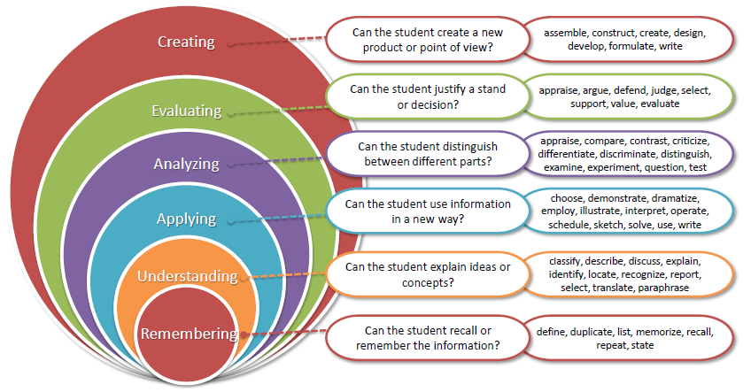
Bloom’s taxonomy
www.lpu.in Lovely Professional University
6

Slide 7
Contents
Unit I
Understanding Cloud Computing: Origins and Influences, Cluster Computing, Grid Computing, Utility Computing, Distributed Computing, Cloud Computing, Basic Concepts and Terminologies, Vision of Cloud Computing, Goal and Benefits, Risks and Challenges.
Fundamental Concepts and Models: Roles and Boundaries, Cloud Characteristics, Cloud Delivery Models: IaaS, PaaS, SaaS, Combining Cloud Delivery Models, Cloud Deployment Models: Public Cloud, Private Cloud, Community Cloud and Hybrid Cloud.
Unit II
Cloud Enabling Technology: Broadband Networks and ISPs, Internet Architecture, Data Centre Technology, Virtualization Technology, Understanding type 1 and type 2 Hypervisor, Types of Virtualization, Benefits of Virtualization, Virtualization Technology Examples- Xen, Vmware, Microsoft Hyper-V, Web Technology, Multi-tenant Technology, Service Technology.
Using the Mobile Cloud: Defining the Mobile Market, Using Smartphones with Cloud, Mobile Interoperability, Mobile location awareness.
www.lpu.in Lovely Professional University
7

Slide 8
Contents
Unit III
Cloud Computing Architecture: Cloud Reference Model, Workload Distribution, Resource Pooling, Dynamic Scalability, Elastic Resource Capacity, Service Load Balancing, Cloud bursting, Elastic Disk Provisioning, Redundant Storage, Load Balancing Virtual Server Instances, Zero Downtime, Cloud Balancing, Dynamic Failure Detection and Recovery Mechanism, Rapid Provisioning, Load Balanced Virtual Switches.
Unit IV
Cloud Security: Basic Terms and Concepts, Threat Agents, Cloud Security Threats, Cloud Risk Division and Risk Management, Cloud Security Architecture, VM Security Challenges, Vulnerability Assessment Tools for Cloud- Netskope, CipherCloud, Skyhigh Networks, Okta, Qualys and Vaultive, Open Source Security Solution Products in Cloud- OSSEC-HIDS and SNORT.
Unit V:
Private Cloud Computing Platforms and Cloud Testing: Private Cloud Computing Platforms- Introduction to OpenStack and Components of OpenStack, Vmware vClient, TPlatform, Apache Virtual Computing Lab, Enomaly Elastic Computing Platform, CloudStack, Amazon Virtual Private Cloud, Cloud Optimized Linux, Testing in Cloud Computing- Application Testing Strategy in a Cloud Computing Environment, Cloud Simulation Tools- CloudSim, GreenCloud Simulator, iCan Cloud.
www.lpu.in Lovely Professional University
8

Slide 9
Contents
Unit VI:
Cloud Platform in Industry: Amazon Web Services- Compute Services, Storage Services, Database Services, Communication Services, Additional Services, Google App Engine- Architecture and Core Concepts, Application Life Cycle, Cost Model, Microsoft Azure Core Concepts, SQL Azure.
Cloud Applications: Scientific Applications- Healthcare, Biology, Geoscience; Business and Consumer Applications- CRM and ERP, Social Networking, Media Applications, Multiplayer Online Gaming, Cloud Analytics, Cloud Content Delivery Network (CDN) Services.
Advance Topics in Cloud: Containers, Edge Computing, Fog Computing, Energy Efficiency in Cloud, Federated Cloud Computing, Green Cloud Computing, Mobile Cloud Computing, Basics of IoT, Big Data Analytics.
www.lpu.in Lovely Professional University
9

Slide 10
Teaching Methodology
Discussion using Real World Examples: Facebook, Google drive, Google collab, online gaming, electricity distribution (pay per usage)
Video: Playing video of 2-3 minutes
Showing different cloud platforms online
Demonstration: Type-II hypervisor on Vmware and Type-I on HoL, Cloud Simulation Tools- CloudSim
Aware students about MOOC courses
Discussion of current researches in cloud computing and it’s related field.
www.lpu.in Lovely Professional University
10

Slide 11
Practical Applications
Implementation of cloud in health sectors to store data.
Simulation of cloud infrastructure for research purpose.
Analyzing and handling the issue related to security in cloud computing.
Understanding the cloud computing architecture, Reference Model and its’ Failure Management.
www.lpu.in Lovely Professional University
11

Slide 12
COHORTS
A group of students of a common programme who intend to attain similar characteristics by means of learning similar skills in order to target a particular career opportunity.
Purpose of Cohorts:
Student shall be able to have a goal oriented approach for his/her career
Student shall be able to follow the stage wise career progression.
Early identification of skill set required for selected goal.
www.lpu.in Lovely Professional University

Slide 13
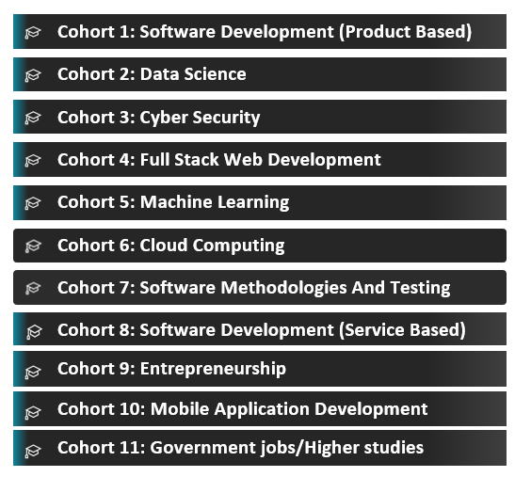
www.lpu.in Lovely Professional University

Slide 14
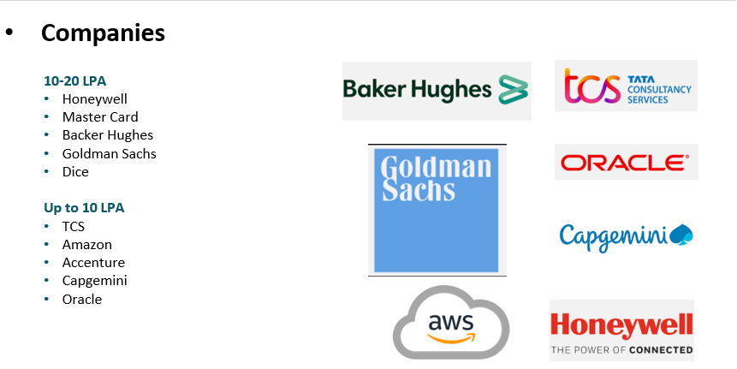
www.lpu.in Lovely Professional University

Slide 15
Latest Trends in Cloud Computing
Cloud Service Providers in Industry:
Amazon Web Services, Google Cloud Services, Microsoft Azure, etc.
Advanced Topics in Cloud Computing
Containers,
Edge Computing,
Fog Computing,
Energy Efficiency in Cloud,
Federated Cloud Computing,
Green Cloud Computing,
Mobile Cloud Computing,
IoT,
Big Data Analytics
www.lpu.in Lovely Professional University
15

Slide 16
Evaluation Criteria
3 CAs will be conducted throughout
CA 1 will be MCQ Based
CA 2 will be Subjective Based
CA 3 will be The Term Paper
Attendance 5 Marks
MTE Subjective
ETE Subjective
www.lpu.in Lovely Professional University
16

Slide 17
Books To Referred
Text Books:
1. CLOUD COMPUTING: CONCEPTS, TECHNOLOGY & ARCHITECTURE by THOMAS ERLRICARDO PUTTINIZAIGHAM MAHMOOD, PEARSON
References:
1. MASTERING CLOUD COMPUTING by RAJ KUMAR BUYYA, CHRISTIAN VECCHIOLA, S. THAMARAI SELVI, MC GRAW HILL
2. CLOUD COMPUTING: FUNDAMENTALS, INDUSTRY APPROACH AND TRENDS by RISHABH SHARMA, WILEY
www.lpu.in Lovely Professional University

Slide 18
Moocs
NPTEL courses
Other Moocs will be shared later
www.lpu.in Lovely Professional University
18

